Slide 1
MNIST Digit Classification with Neural Net
Computing Science
University of Alberta
Nilanjan Ray

Slide 2
Agenda
Building a neural net with PyTorch for MNIST digit recognition
How does backpropagation work?
Softmax function
Cross-entropy loss

Slide 3
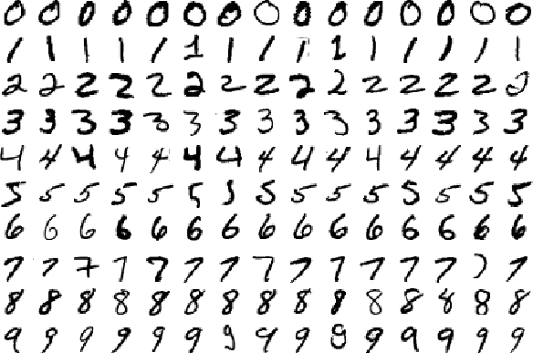
MNIST dataset
Classify images into digits
Each image is 28x28
10 labels
55,000 training images
5,000 validation images
10,000 test images.

Slide 4
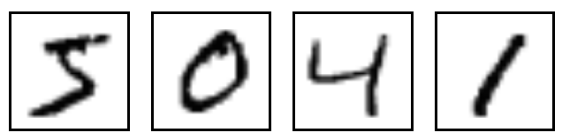
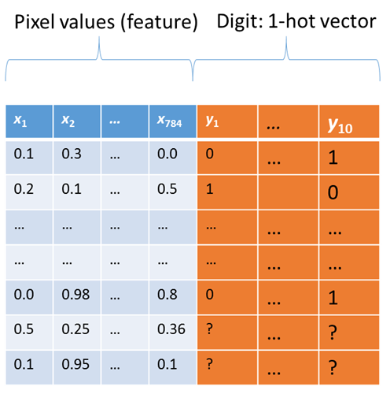
MNIST classification problem
Small 28 pixels-by-28 pixels images of hand written digits
The visual recognition problem definition:
to recognize the digit from an image

Slide 5
NN Architecture for MNIST Classification
X: input
Z1=f(X*W1+b1)
Z1
Z2=f(Z1*W2+b2)
Z2
Z3=Z2*W3+b3
Z3
Yp=Softmax(Z3)
Yp
W1, b1: parameters
W2, b2: parameters
W3, b3: parameters
Activation function, f is ReLU in our implementation

Slide 6



Softmax and cross-entropy loss
Score vector from
neural net
Probabilities
softmax
Cross-entropy loss
logits
yp
y
Ideal probabilities
(1-hot vector)
$${yp}_{i}=\frac{{exp⁡(logits}_{i})}{\sum_{k}{{exp⁡(logits}_{k})}}$$
$$Loss=−\sum_{k}{y_{k}log⁡({yp}_{k})}$$
To backpropagate error, we need to compute:
$$δ{(logits)}_{i}≡\frac{∂\left(Loss\right)}{∂{\left(logits\right)}_{i}}$$

Slide 7

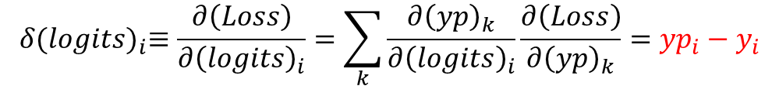
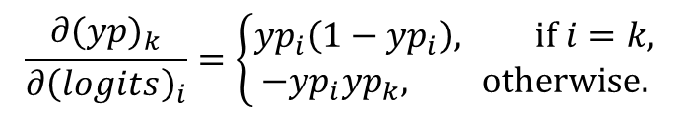


Softmax and cross-entropy loss: backprop
Score vector from
neural net
Probabilities
softmax
Cross-entropy loss
logits
yp
y
Ideal probabilities
(1-hot vector)
$$Loss=−\sum_{k}{y_{k}log⁡({yp}_{k})}$$
$$\frac{∂(Loss)}{∂{(yp)}_{k}}=−\frac{y_{k}}{{yp}_{k}}$$
$${yp}_{i}=\frac{{exp⁡(logits}_{i})}{\sum_{k}{{exp⁡(logits}_{k})}}$$
$$\frac{∂{(yp)}_{k}}{∂{\left(logits\right)}_{i}}=\left\{\begin{matrix}{yp}_{i}\left(1−{yp}_{i}\right), if i=k, \\ −{yp}_{i}{yp}_{k}, otherwise.\end{matrix}\right.$$
$$δ{(logits)}_{i}≡\frac{∂\left(Loss\right)}{∂{\left(logits\right)}_{i}}=\sum_{k}{\frac{∂{\left(yp\right)}_{k}}{∂{\left(logits\right)}_{i}}\frac{∂\left(Loss\right)}{∂{\left(yp\right)}_{k}}}={yp}_{i}−y_{i}$$
Using the above two results in the chain rule,
What if, instead of cross-entropy, we used L2 loss along with softmax?

Slide 8


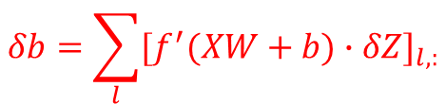
Backprop across a neural net layer
Z=f(XW+b)
X: input
Z: output
W, b: parameters
Pointwise multiplication
Backprop
rules:
$$δb=\sum_{l}{{[f^{′}(XW+b)∙δZ]}_{l,:}}$$
$$δX=[f^{′}(XW+b)∙δZ]∗W^{T}$$
$$δW=X^{T}∗[f^{′}(XW+b)∙δZ]$$
Matrix multiplication

Slide 9




Backprop across a neural net layer: derivation
Z=f(XW+b)
X: input
Z: output
Z₁ = XW
Z₂ = Z₁+b
Z = f(Z₂)
X
*
+
f
W
b
W, b: parameters
$$δZ_{2}=f^{′}(Z_{2})δZ$$
Apply chain rule
to computational
nodes:
$$δZ_{1}=δZ_{2}$$
$$δX=[f^{′}(XW+b)∙δZ]∗W^{T}$$
$$δX=δZ_{1}W^{T}$$
Similarly, we can derive backprop rules for δW and δb

Slide 10
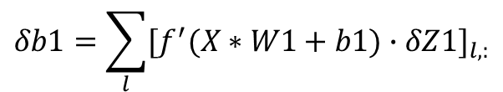

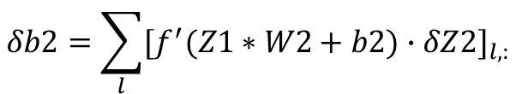
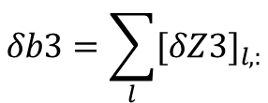

NN for MNIST Classification: Gradients
X: input
Z1=f(X*W1+b1)
Z1
Z2=f(Z1*W2+b2)
Z2
Z3=Z2*W3+b3
Z3
Yp=Softmax(Z3)
Yp
W1, b1: parameters
W2, b2: parameters
W3, b3: parameters
Backprop:
$$δb3=\sum_{l}{{[δZ3]}_{l,:}}$$
δZ3 = Yp-Y
$$δW3={Z2}^{T}∗δZ3$$
δZ2 = δZ3 * W3^{T}
$$δW2={Z1}^{T}∗[f^{′}(Z1∗W2+b2)∙δZ2]$$
$$δb2=\sum_{l}{{[f^{′}(Z1∗W2+b2)∙δZ2]}_{l,:}}$$
δZ1 = [f’(Z1*W2+b2).δZ2] * W2^{T}
$$δW1=X^{T}∗[f^{′}(X∗W1+b1)∙δZ1]$$
$$δb1=\sum_{l}{{[f^{′}(X∗W1+b1)∙δZ1]}_{l,:}}$$

Slide 11


Learning MNIST NN with Backprop and SGD
Initialize all parameters of the neural network
Initialize learning rate variable lr
Iterate:
(Load Data): Get training data batch X
(Forward pass): Compute Z1, Z2, Z3, Yp
(Backward pass): Compute gradients δZ3, δZ2, δZ1, δW3, δW2, δW1, δb3, δb2, δb1
(Gradient descent to update parameters):
$$W3←W3−lr∗δW3,$$
$$b3←b3−lr∗δb3,…,$$
(Diagnostics): Compute “Loss” from time to time to check if it is decreasing

